Slide 1
Development of a Corneal Scrape
Visual Standard Operating Procedure
Dr James Yeo, GPST1
Dr Tom Lewis, Consultant Microbiologist

Slide 2
Why an S.O.P.
Lean Improvement
What is the best way to manage a patient with keratitis to minimise harm and optimise treatment.
Current State
  No specific national or local guidelines on HOW to sample or WHAT organisms to sample for.

Slide 3
What we know.
Little or no differentiation in the literature between potential contamination organisms and pathogens.
Little reference to the risks of managing misidentified organisms.
No clear guideline for the practical procedure of performing an effective scrape.
No gold standard.

Slide 4
Collaborative working
Alignment of the needs of the patient with
  The requirements of the ophthalmology clinician
  Effective processing microbiology samples
  Effective reporting of organisms and sensitivities
  Reducing waste

Slide 5
SOP Objective
Reproducible method
Easy to Follow, stepwise procedure
Reduce the risk of contamination
Maintaining best practice
Aseptic technique
To isolate an organism that will allow targeted treatment of the patient and preserve their sight

Slide 6
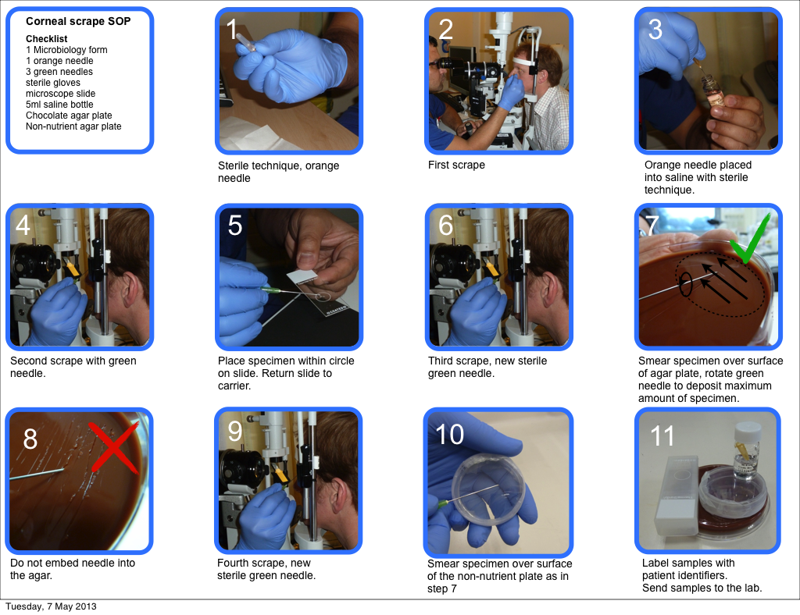

Slide 7
Corneal Scrape, Pathogens and Contamination rates 2008 to 2013

Slide 8
Pathogens vs Contaminants
Highly likely Pathogens;
Acanthamoeba, Pseudomonus aeruginosa, mycobacteria, fungi
Implicated as Pathogens;
Staph. aureus, Strep. pneumoniae, Moraxella
Probable Contaminants;
Mixed culture or isolation of Staph epidermidis

Slide 9
Next steps in development
When to precede to corneal biopsy?
The value of swabs from around the ulcer to identify colonizing flora
How to further maximise yield?
Further requirements from the Ophthalmology team.

